Slide 1

Decision Tree
Random Forest
Copyright © www.ITbodhi.com

Slide 2
Decision Trees
A supervised learning predictive model that uses a set of binary rules to calculate a target value
Used for either classification(categorical variables) or regression(continuous variables)
In this method, the given data is split into one or more homogeneous sets based on most significant input variable
Tree generating algorithm determines
- Which variable to split at a node
- Decision to stop or make a split again
- Assign terminal nodes to a class
Copyright © www.ITbodhi.com

Slide 3
Decision Trees
Sno | Species Name | Body_Temp | Gives_Birth | Type
1 | SP101 | Cold-Blooded | No | Non-Mammal
2 | SP102 | Warm-Blodded | No | Non-Mammal
3 | SP103 | Cold-Blooded | No | Non-Mammal
4 | SP104 | Warm-Blodded | Yes | Mammal
5 | SP105 | Warm-Blodded | No | Non-Mammal
6 | SP106 | Warm-Blodded | No | Non-Mammal
7 | SP107 | Warm-Blodded | Yes | Mammal
8 | SP108 | Cold-Blooded | No | Non-Mammal
9 | SP109 | Cold-Blooded | No | Non-Mammal
10 | SP110 | Warm-Blodded | Yes | Mammal
11 | SP111 | Warm-Blodded | Yes | Mammal
12 | SP112 | Warm-Blodded | No | Non-Mammal
13 | SP113 | Cold-Blooded | No | Non-Mammal
14 | SP114 | Warm-Blodded | Yes | Mammal
Copyright © www.ITbodhi.com

Slide 4
Decision Trees
The decision tree will be created as follows:
The splits will be done to partition the data into purer subsets. So, when the split is done on Body Temperature, all the species that are cold-blooded are found to be “non-mammals”. So when the Body Temperature is “Cold- Blooded”, we get a purest subset where all the species belong to “non-Mammals”.
But for “warm-blooded” species, we still have both types present: mammals and non-mammals. So, now the algorithm splits on the values of Gives_Birth. This time, when the values are “Yes”, we get all type values as “Mammals” and when the values are “No”, we get all type values as “Non-Mammals”.
The nodes represents Attributes while the edges represent values.
Copyright © www.ITbodhi.com

Slide 5
Decision Tree – An Example
Body Temperature
Warm
Cold
Gives Birth
Non-Mammals
Yes
No
Mammal
Non-Mammal
Copyright © www.ITbodhi.com

Slide 6
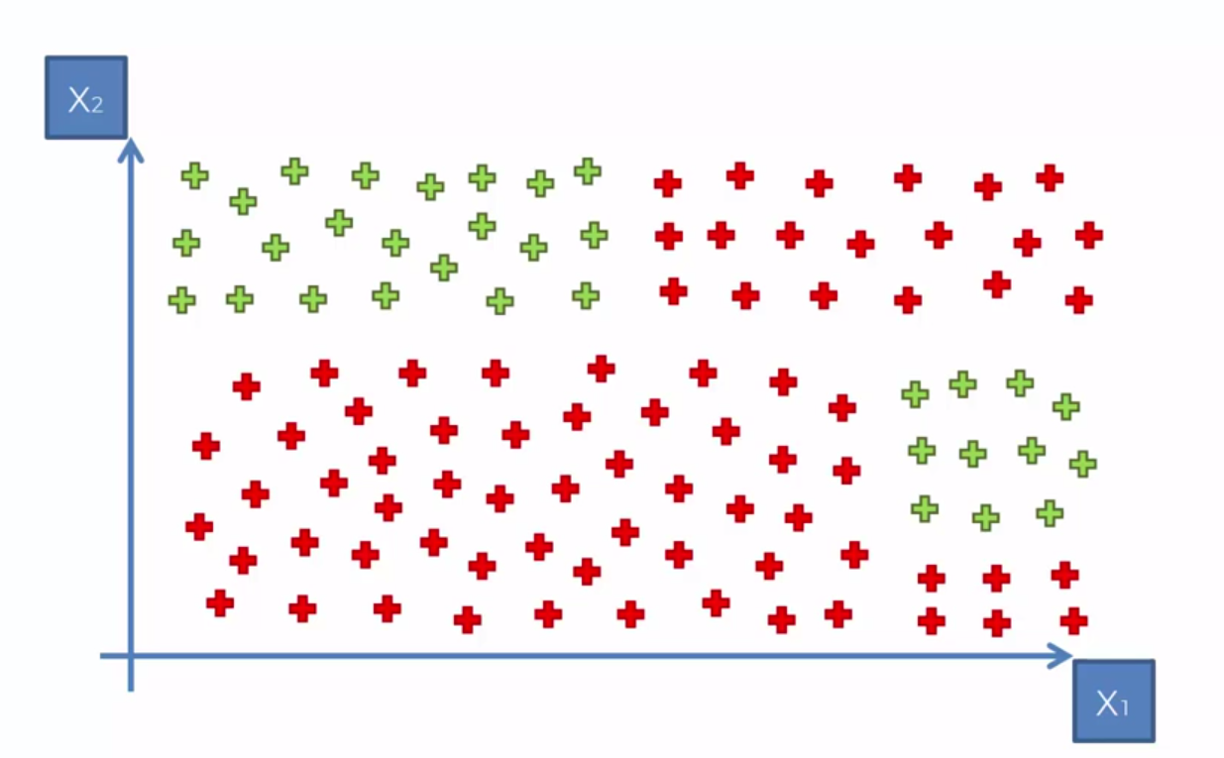
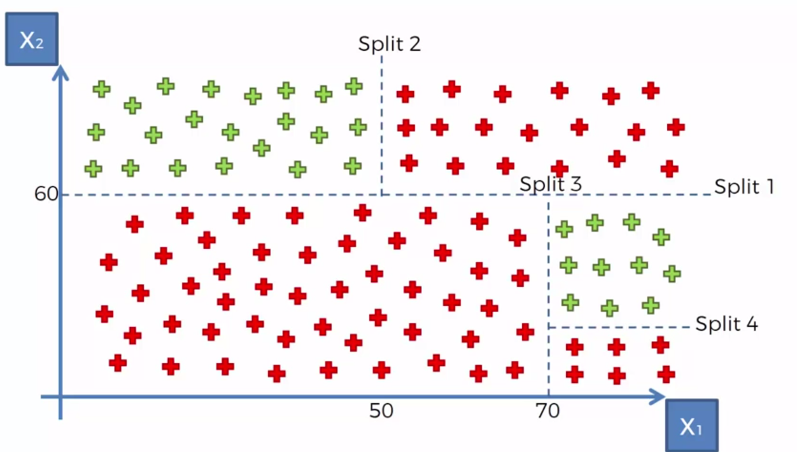
Decision Tree – Another Example
Copyright © www.ITbodhi.com

Slide 7
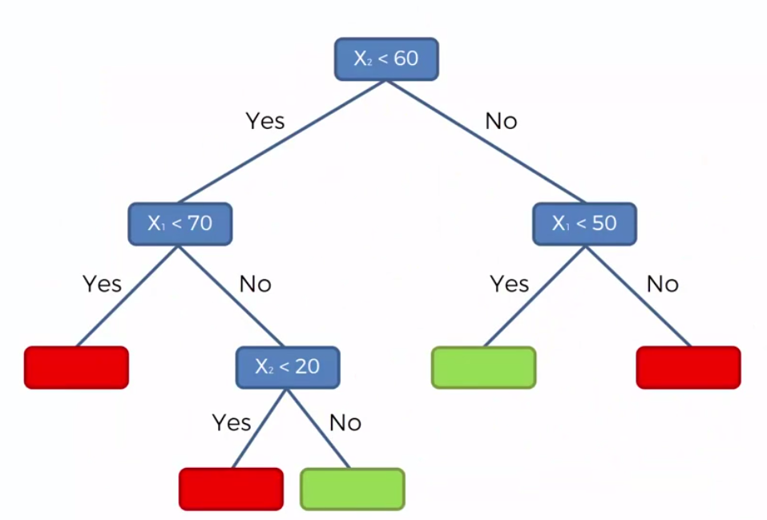
Decision Tree – Another Example
Copyright © www.ITbodhi.com

Slide 8
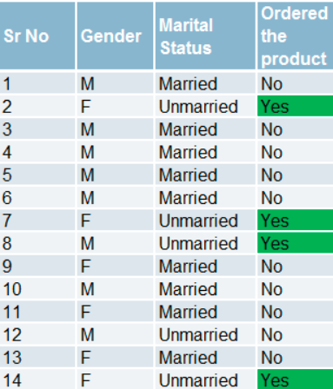
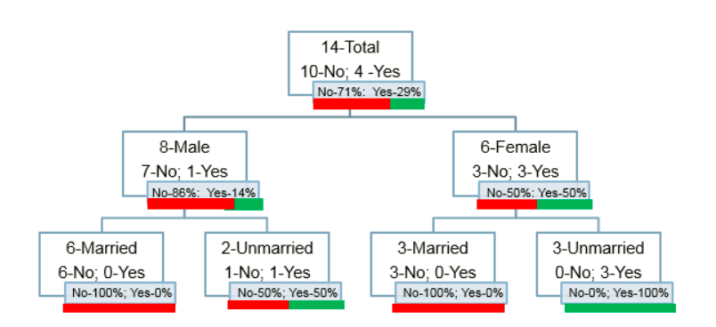
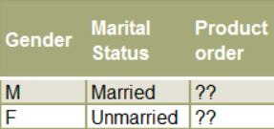
Decision Tree – Another Example
Copyright © www.ITbodhi.com

Slide 9
Measures Used for Split
CART (Classification and Regression Trees) → uses Gini Index(Classification) as metric.
ID3 (Iterative Dichotomiser 3) → uses Entropy function and Information gain as metrics.
Reduction in Variance
Reduction in variance is an algorithm used for continuous target variables (regression problems)
This algorithm uses the standard formula of variance to choose the best split
Copyright © www.ITbodhi.com

Slide 10

Gini
Gini Index: It is the measure of inequality of distribution. It says if we select two items from a population at random then they must be of same class and probability for this is 1 if population is pure.
It works with categorical target variable “Success” or “Failure”.
It performs only Binary splits
Lower the value of Gini, higher the homogeneity.
CART (Classification and Regression Tree) uses Gini method to create binary splits.
Process to calculate Gini Measure:
P(j) is the Probability of Class j
A Gini score gives an idea of how good a split is by how mixed the classes are in the two groups created by the split. A perfect separation results in a Gini score of 0, whereas the worst case split that results in 50/50 classes.
We calculate it for every row and split the data accordingly in our binary tree. We repeat this process recursively.
Copyright © www.ITbodhi.com

Slide 11
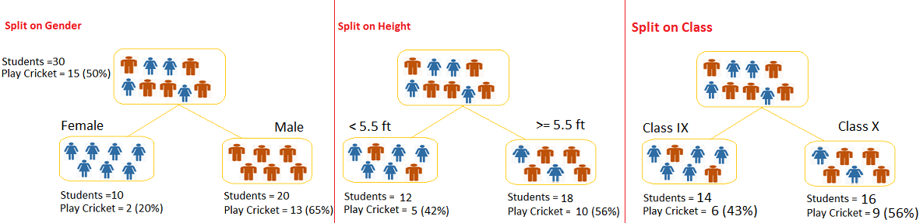
Split Example
Let’s say we have a sample of 30 students with three variables Gender (Boy/ Girl), Class( IX/ X) and Height (5 to 6 ft). 15 out of these 30 play cricket in leisure time. Now, I want to create a model to predict who will play cricket during leisure period?
Copyright © www.ITbodhi.com

Slide 12


Entropy
Entropy is a way to measure impurity.
Less impure node requires less information to describe it and more impure node requires more information. If the sample is completely homogeneous, then the entropy is zero and if the sample is an equally divided it has entropy of one.
Copyright © www.ITbodhi.com

Slide 13

Information Gain
Information Gain is simply a mathematical way to capture the amount of information one gains(or reduction in randomness) by picking a particular attribute
In a decision algorithm, we start at the tree root and split the data on the feature that results in the largest information gain (IG). In other words, IG tells us how important a given attribute is.
The Information Gain (IG) can be defined as follows:
Copyright © www.ITbodhi.com

Slide 14
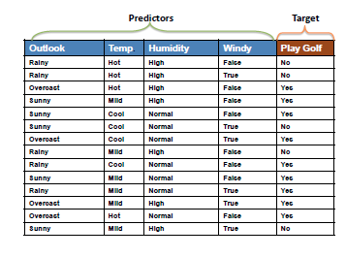
Copyright © www.ITbodhi.com

Slide 15
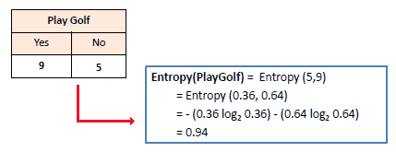
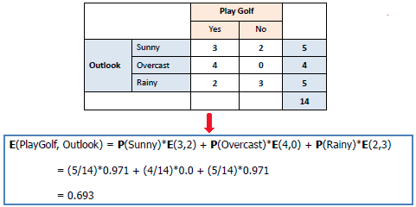
Copyright © www.ITbodhi.com

Slide 16
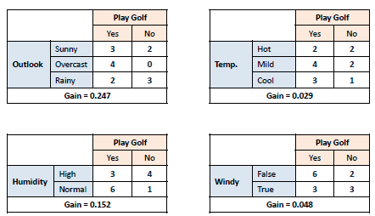
Copyright © www.ITbodhi.com

Slide 17
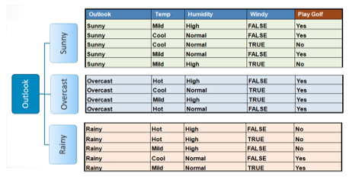
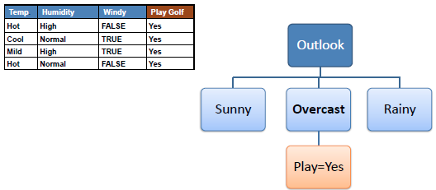
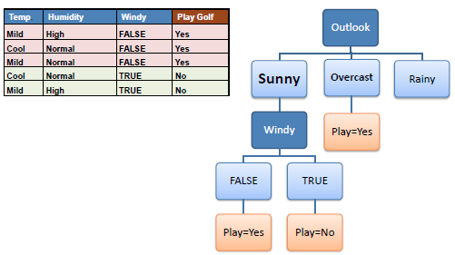
Copyright © www.ITbodhi.com

Slide 18
Pros and Cons of Decision Trees
Advantages of Decision Trees:
Its very interpretable and hence easy to understand
It can be used to identify the most significant variables in your data-set
Disadvantages:
The model has very high chances of “over-fitting”
If the relationship between dependent & independent variable is well approximated by a linear model, linear regression will outperform tree based model.
If there is a high non-linearity and complex relationship between dependent & independent variables, a tree model will outperform a classical regression method.
Copyright © www.ITbodhi.com

Slide 19
Avoiding Overfitting in Decision Trees
Overfitting is the key challenge in case of Decision Trees.
If no limit is set, in the worst case, it will end up putting each observation into a leaf node.
It can be avoided by setting Constraints on Tree Size
Copyright © www.ITbodhi.com

Slide 20
Parameters for Decision Trees
Following parameters are used for limiting Tree Size:
Minimum samples for a node split: It defines minimum number of observations which are required in a node to be considered for splitting.
Minimum samples for a terminal node (leaf): Defines the minimum samples (or observations) required in a terminal node or leaf. Generally lower values should be chosen for imbalanced class problems because the regions in which the minority class will be in majority will be very small.
Maximum depth of tree: Higher depth can cause overfitting
Maximum number of terminal nodes
Maximum features to consider for split: As a thumb-rule, square root of the total number of features works great but we should check upto 30-40% of the total number of features.
Copyright © www.ITbodhi.com

Slide 21
Validation
When creating a predictive model, we'd like to get an accurate sense of its ability to generalize to unseen data before actually going out and using it on unseen data.
A complex model may fit the training data extremely closely but fail to generalize to new, unseen data. We can get a better sense of a model's expected performance on unseen data by setting a portion of our training data aside when creating a model, and then using that set aside data to evaluate the model's performance.
This technique of setting aside some of the training data to assess a model's ability to generalize is known as validation.
Holdout validation and cross validation are two common methods for assessing a model before using it on test data.
Copyright © www.ITbodhi.com

Slide 22
Holdout Validation
Holdout validation involves splitting the training data into two parts, a training set and a validation set, building a model with the training set and then assessing performance with the validation set.
Some Disadvantages:
Reserving a portion of the training data for a holdout set means you aren't using all the data at your disposal to build your model in the validation phase. This can lead to suboptimal performance, especially in situations where you don't have much data to work with.
If you use the same holdout validation set to assess too many different models, you may end up finding a model that fits the validation set well due to chance that won't necessarily generalize well to unseen data.
Copyright © www.ITbodhi.com

Slide 23
Cross-Validation
Cross-Validation is a process of leaving a sample on which you do not train the model and test the model on this sample.
To do 10-fold cross validation:
we divide the training data equally into 10 sets.
Train the model over 9 sets, while holding back the 10th set
Test the model on the set which is held back and save the results
Repeat the process 9 more times by changing the data set which is held back
Average out the results
The result is a more reliable estimate of the performance of the algorithm on new data. It is more accurate because the algorithm is trained and evaluated multiple times on diﬀerent data. The choice of k must allow the size of each test partition to be large enough to be a reasonable sample of the problem, whilst allowing enough repetitions of the train-test evaluation of the algorithm to provide a fair estimate of the algorithms performance on unseen data. For modest sized datasets in the thousands or tens of thousands of records, k values of 3, 5 and 10 are common.
Copyright © www.ITbodhi.com

Slide 24
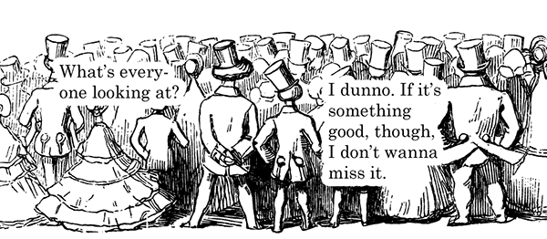
Wisdom of crowd
Copyright © www.ITbodhi.com

Slide 25
Ensemble
Ensembling: Ensembling is a process of combining the results of multiple models to solve a given prediction or classification problem.
The three most popular methods for combining the predictions from diﬀerent models are:
Bagging: Building multiple models (typically of the same type) from diﬀerent subsamples of the training dataset. A limitation of bagging is that the same greedy algorithm is used to create each tree, meaning that it is likely that the same or very similar split points will be chosen in each tree making the different trees very similar (trees will be correlated). This, in turn, makes their predictions similar. We can force the decision trees to be different by limiting the features that the greedy algorithm can evaluate at each split point when creating the tree. This is called the Random Forest algorithm.
Boosting: Building multiple models (typically of the same type) each of which learns to ﬁx the prediction errors of a prior model in the sequence of models.
Voting: Building multiple models (typically of diﬀering types) and simple statistics (like calculating the mean) are used to combine predictions.
Copyright © www.ITbodhi.com

Slide 26
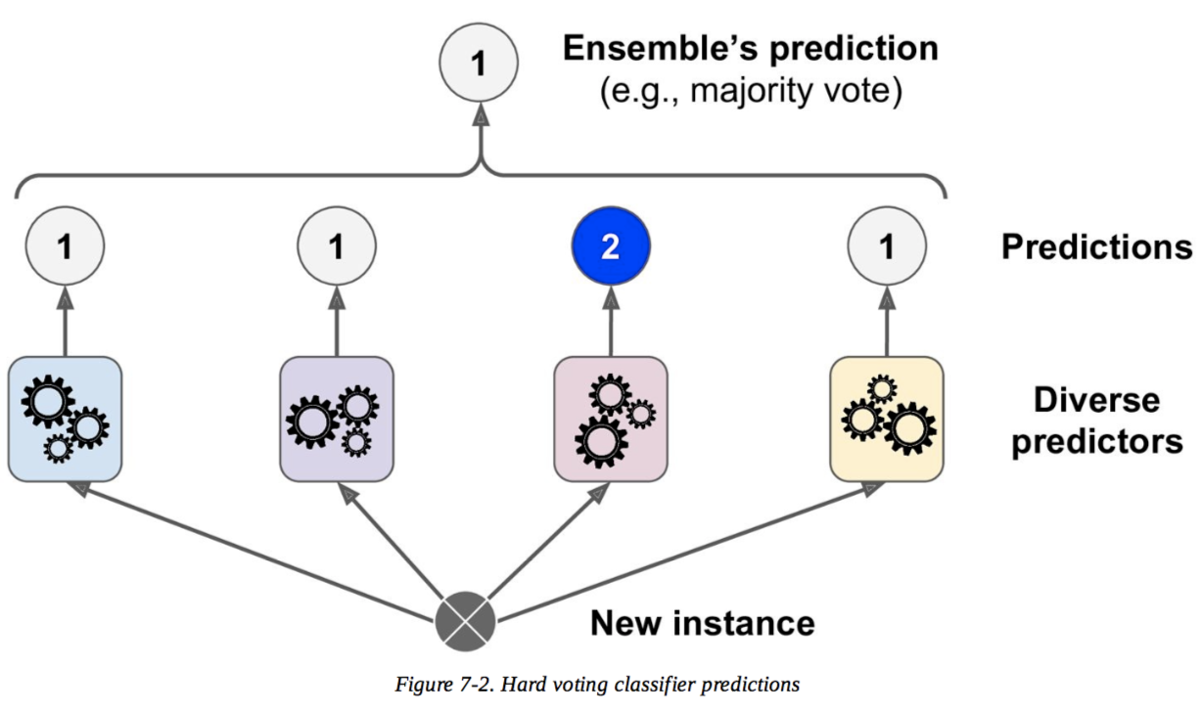
Voting Classifier – Majority/Hard Voting
Copyright © www.ITbodhi.com

Slide 27

Voting Classifier – Soft Voting
Specific weights can be assigned to each classifier via the weights parameter.
When weights are provided, the predicted class probabilities for each classifier are collected, multiplied by the classifier weight, and averaged.
The final class label is then derived from the class label with the highest average probability.
W=.2
W=.5
W=.3
W=.3
Copyright © www.ITbodhi.com

Slide 28
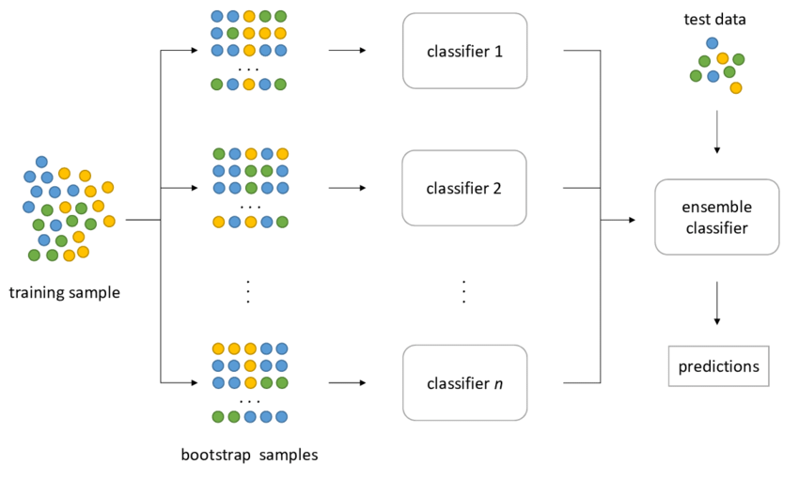
Bagging & Pasting
Bagging is when sampling is done with replacement (WR).
Pasting is when sampling is done without replacement(WOR).
Ensemble make prediction by simply aggregating the prediction of all predictors(just like hard voting).
Generally the net result is that ensemble has similar bias but lower variance.
Bagging( WR ) – bootstrap = True | Pasting(WOR) – bootstrap = False
Bagging performs best with algorithms that have high variance. A popular example are decision trees, often constructed without pruning.
Copyright © www.ITbodhi.com
Notes:
For example, if we catch fish, measure them, and immediately return them to the water before continuing with the sample, this is a WR design, because we might end up catching and measuring the same fish more than once. However, if we do not return the fish to the water, this becomes a WOR design. If we tag and release the fish we caught, we can see whether we have caught a particular fish before.

Slide 29
Random Forests
Random Forests: Random Forests is an ensemble(bagging) modeling technique that works by building large number of decision tress. It takes a subset of observations and a subset of variables to build several decision trees. Each tree will play a role in determining the final outcome.
A random forest builds many trees. In forming each tree, it randomly selects the independent variables. This means that data used as training data for each tree is selected randomly with replacement. Each tree will give its output. The final output will be a function of each individual tree output.
The function can be:
Mean of individual probability outcomes
Vote Frequency
The important parameters used while using RandomForestClassifier in Python are:
n_estimators is used to fix number of trees in Random Forest.
max_depth - parameter determining when the splitting up of the decision tree stops.
min_samples_split - parameter monitoring the amount of observations in a bucket
Copyright © www.ITbodhi.com

Slide 30
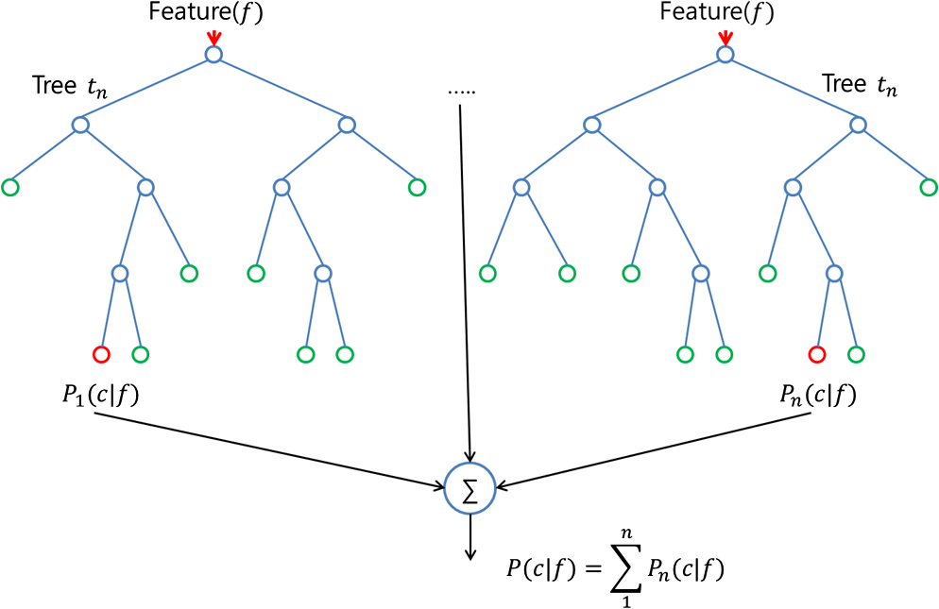
Random Forests
Copyright © www.ITbodhi.com

Slide 31
An Example
Lets say we have to decide whether a cricket player is Good or Bad. We can have the as “average runs scored” against various variables like “Opposition Played”, “Country Played”, “Matches Won”, “Matches Lost” and many others. We can use a decision tree which splits on only certain attributes, to determine whether this player is Good or Bad. But we can improve our prediction, if we build a number of decision trees which split on different combination of variables. Then using the outcome of each tree, we can decide upon our final classification. This will greatly improve the performance which we get using a single tree. Another example can be the judgements delivered by Supreme Court. Supreme Court usually employs a bench of judges to deliver a judgement. Each judge gives its own judgment and then the outcome which gets the maximum voting becomes the final judgement.
Copyright © www.ITbodhi.com

Slide 32
An Example
Suppose, you want to watch a movie ‘X’ . You ask your friend ‘Amar’ if you should watch this movie.
Amar asks you a series of questions:
What previous movies you watched? Which of these movies you liked or disliked? Is X a romantic movie? Does Salman Khan act in movie X?
….. And several other questions. Finally Amar tells you either Yes or No.
Amar is a decision tree for your movie preference.
But Amar may not give you accurate answer. In order to be more sure, you ask couple of friends – Rita, Suneet and Megha, the same question. They will each vote for the movie X. (This is ensemble model aka Random Forest in this case)
If you have a similar circle of friends, they may all have the exact same process of questions, so to avoid them all having the exact same answer, you’ll want to give them each a different sample from your list of movies. You decide to cut up your list and place it in a bag, then randomly draw from the bag, tell your friend whether or not you enjoyed that movie, and then place that sample back in the bag. This means you’ll be randomly drawing a sub sample from your original list with replacement (bootstrapping your original data)
And you will just make sure that , each of your friends asks different questions randomly.
Copyright © www.ITbodhi.com

Slide 33
Uses – Random Forest
Variable Selection: One of the best use cases for random forest is feature selection. One of the byproducts of trying lots of decision tree variations is that you can examine which variables are working best/worst in each tree.
Classification: Random forest is also great for classification. It can be used to make predictions for categories with multiple possible values
Copyright © www.ITbodhi.com

